Slide 1
Lesson 2

Slide 2
let's remember what was on the previous lesson

Slide 3
Structured Steaming
Structured Streaming
DataStreamReader
DataStreamWriter
Streaming Source
Streaming Sink
Streaming Query
StreamingQueryManager
Structured Streaming is a computation model since Spark 2.0 that is an attempt to unify streaming, interactive, and batch query execution engines
Structured Streaming is a stream processing engine with a high-level declarative streaming API built on top of Spark SQL allowing for continuous incremental execution of a structured query.
lines_df = spark. \ read. \ // <-- batch non-streaming query text("/data/sales/") >> batchQuery.isStreaming res0: Boolean = false
lines_df = spark. \ readStream. \ // <-- streaming query text("/data/sales/")

Slide 4
Stream Reader
Structured Streaming
DataStreamReader
DataStreamWriter
Streaming Source
Streaming Sink
Streaming Query
StreamingQueryManager
DataStreamReader is the interface for loading data
lines = spark \ .readStream \ .format("kafka") \ .option("kafka.bootstrap.servers", bootstrapServers) \ .option(subscribeType, topics) \ .load()
2. Structured query is described using Dataset API

Slide 5
Stream Writer
Structured Streaming
DataStreamReader
DataStreamWriter
Streaming Source
Streaming Sink
Streaming Query
StreamingQueryManager
DataStreamWriter is the interface for writing result of a streaming query to a data sink
from pyspark.sql import SparkSession
query = wordCounts \ .writeStream \ .outputMode('complete') \ .format('console') \ .start()

Slide 6
Source
Structured Streaming
DataStreamReader
DataStreamWriter
Streaming Source
Streaming Sink
Streaming Query
StreamingQueryManager
Streaming Source acts as a continuous stream of data for a streaming query
Defined using format method on DataStreamReader
Uses shortName of a source
FileStreamSource and TextSocketSource
KafkaSource for Apache Kafka 0.10+
MemoryStream for unit tests, PoCs, tutorials and debugging
lines = spark \ .readStream \ .format("kafka") \ .option("kafka.bootstrap.servers", bootstrapServers) \ .option(subscribeType, topics) \ .load()

Slide 7
Sink
Structured Streaming
DataStreamReader
DataStreamWriter
Streaming Source
Streaming Sink
Streaming Query
StreamingQueryManager
Streaming Sink represents an external storage to write streaming datasets to.
Defined using format method on DataStreamWriter
Uses shortName of a sink
ConsoleSink, FileStreamSink and ForeachSink
KafkaSink for Apache Kafka 0.10+
MemorySink for unit tests, tutorials and debugging
query = wordCounts \ .writeStream \ .outputMode('complete') \ .format('console') \ .start()

Slide 8
Query
Structured Streaming
DataStreamReader
DataStreamWriter
Streaming Source
Streaming Sink
Streaming Query
StreamingQueryManager
StreamingQuery represents a streaming query
import org.apache.spark.sql.streaming.StreamingQuery val query: StreamingQuery = counter.writeStream.start
id is the unique id of a query
runId is the unique id of the run of a query
Use awaitTermination to wait for the termination of a query, either by query.stop or by an exception
Use stop to stop execution of a query
query = wordCounts \ .writeStream \ .outputMode('complete') \ .format('console') \ .start() query.awaitTermination()

Slide 9
Query Manager
Structured Streaming
DataStreamReader
DataStreamWriter
Streaming Source
Streaming Sink
Streaming Query
StreamingQueryManager
StreamingQueryManager is the management interface for streaming queries in a single SparkSession.
StreamingQueryManager manages streaming queries and allows for:
Getting all active structured queries
Getting a structured query by id
Waiting for any streaming query to be terminated
Registering or de-registering StreamingQueryListeners
StreamingQueryManager is available using SparkSession and streams property.
spark = SparkSession \ .builder \ .appName("StructuredKafkaWordCount") \ .config("spark.ui.port", "44040" ) \ .getOrCreate()

Slide 10
Demo
Demo: Kafka - Write and Read data
Time: 20 minutes
producer_wordcount.py
ex02_kafka_wordcount.py

Slide 11
Exercise
Develop a standalone Spark SQL application
Use PyCharm
Add more details
Use text format for source and console for sink
Time: 30 minutes
producer_wordcount.py
ex02_kafka_wordcount.py

Slide 12
Complex Structured Streaming

Slide 13
Event Time
Many use cases require aggregate statistics by event time
E.g. what's the #errors in each system in the 1 hour windows?
Many challenges
Extracting event time from data, handling late, out-of-order data
DStream APIs were insufficient for event-time stuff

Slide 14
Event Time Aggregations
Windowing is just another type of grouping in Structured Streaming
number of records every hour
parsedData .groupBy(window("timestamp","1 hour")) .count()
avg signal strength of each device every 10 mins
parsedData .groupBy( "device", window("timestamp","10 mins")) .avg("signal")
Support UDAFs!

Slide 15
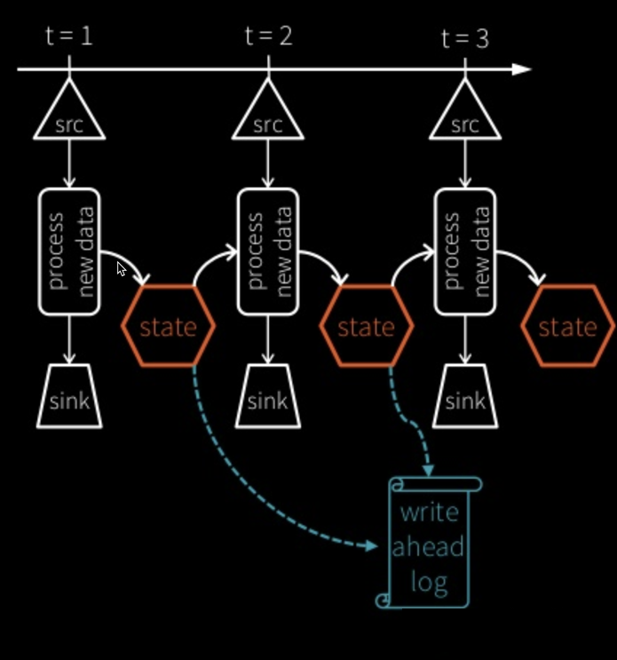
Stateful Processing for Aggregations
Aggregates has to be saved as distributed state between triggers
Each trigger reads previous state and writes updated state
State stored in memory, backed by write ahead log in HDFS/S3
Fault-tolerant, exactly-once guarantee!

Slide 16
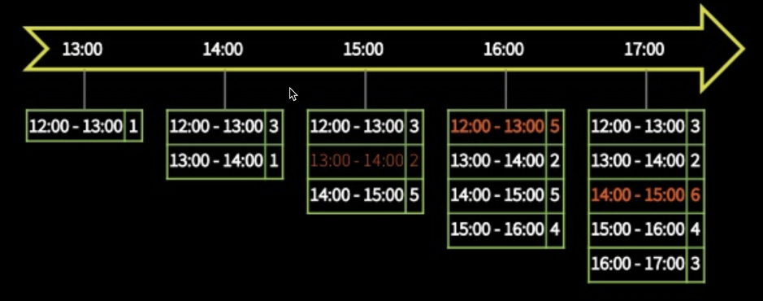
Automatically handles Late Data
Keeping state allows late data to update counts of old windows red = state updated with late data
But size of the state increases indefinitely if old windows are not dropped
Red = state updated with late data

Slide 17
Demo
Demo: Kafka - Write and Read data
Time: 20 minutes
producer_wordcount.py
ex02_kafka_wordcount.py

Slide 18
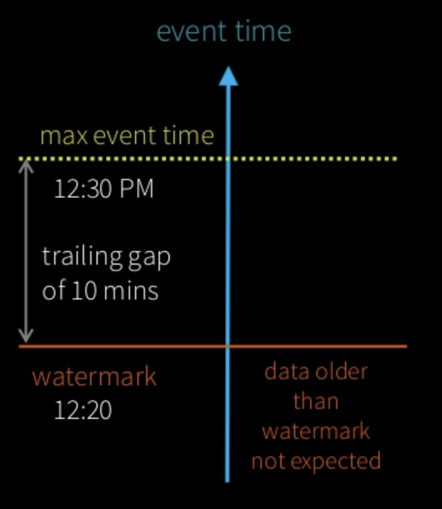
Watermarking
Watermark - moving threshold of how late data is expected to be and when to drop old state
Trails behind max event time seen by the engine
Watermark delay = trailing

Slide 19
Watermarking
Watermark - moving threshold of how late data is expected to be and when to drop old state
Trails behind max event time seen by the engine
Watermark delay = trailing

Slide 20
Watermarking
Data newer than watermark may be late, but allowed to aggregate
Data older than watermark is "too late" and dropped
Windows older than watermark automatically deleted to limit the amount of intermediate state
event time
max event time
watermark
Data older than watermark not expected

Slide 21
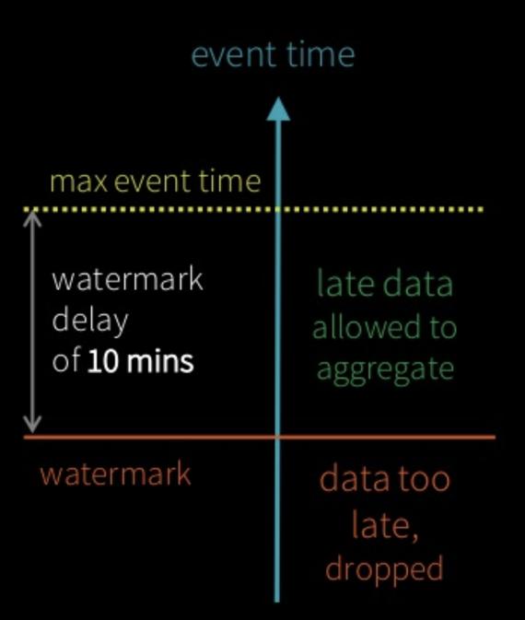
Watermarking
parsedData .withWatermark("timestamp", "10 minutes") .groupBy(window("timestamp","5 minutes")) .count()
Useful only in stateful operations
Ignored in non-stateful streaming queries and batch queries watermark delay of 10 mins

Slide 22
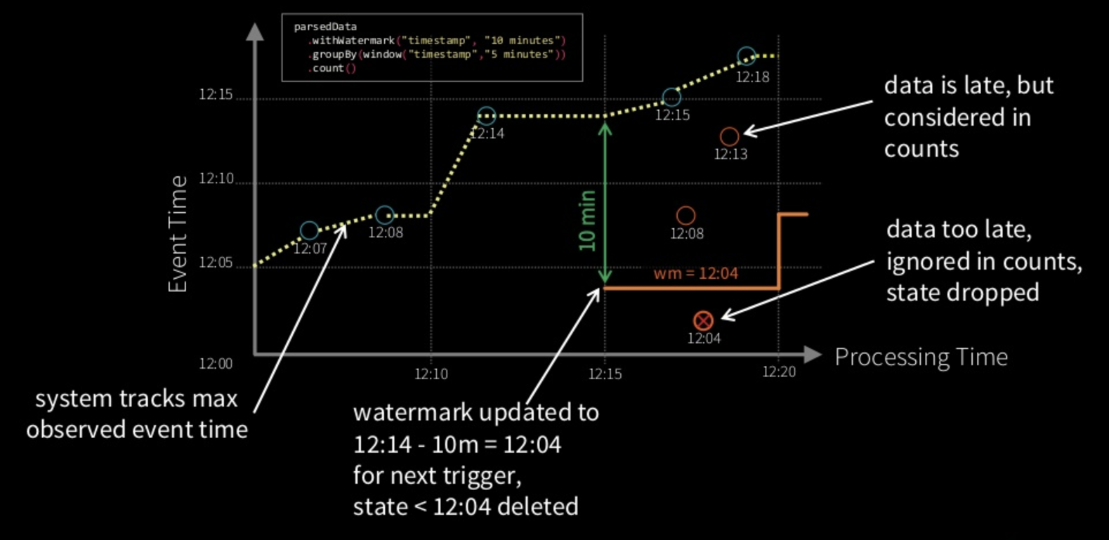
Watermarking

Slide 23
Clean separation of concerns
Query Semantics
How to group data by time? (same for batch & streaming)
Processing Details
How late can data be?
How often to emit updates?
parsedData .withWatermark("timestamp", "10 minutes") .groupBy(window("timestamp","5 minutes")) .count() .writeStream .trigger("10 seconds") .start()

Slide 24
Other Interesting Operations
Streaming Deduplication
Watermarks to limit state
Joins
Stream-batch joins supported, stream-stream joins coming in 2.3
Arbitrary Stateful Processing [map|flatMap]GroupsWithState
parsedData.dropDuplicates("eventId")
parsedData.join(batchData, "device")
ds.groupByKey(_.id) .mapGroupsWithState (timeoutConf) (mappingWithStateFunc)

Slide 25
Monitoring Streaming Queries
Get last progress of the streaming query
Current input and processing rates
Current processed offsets
Current state metrics
Get progress asynchronously through by registering your own StreamingQueryListener new StreamingQueryListener
{ def onQueryStart(...) def onQueryProgress(...) def onQueryTermination(...) } streamingQuery.lastProgress() { ... "inputRowsPerSecond" : 10024.225210926405, "processedRowsPerSecond" : 10063.737001006373, "durationMs" : { ... }, "sources" : [ ... ], "sink" : { ... } ... }

